Slide 1

Predicting High Rating Score among trip advisor Restaurant Reviews A Machine Learning Model
Dganit Haytner Elias

Slide 2
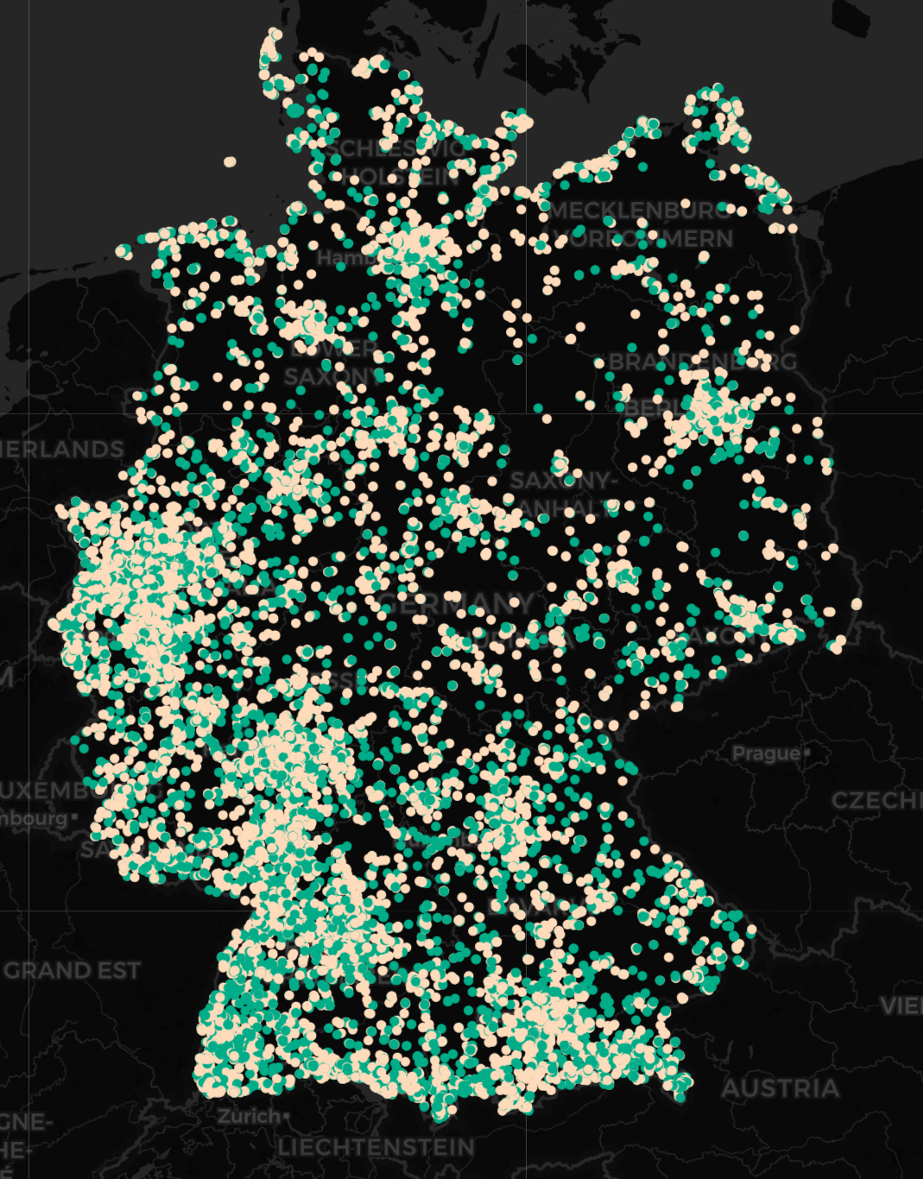
Objective data
e.g. €4-€15
High % Indication
e.g. Working hours
Subjective
e.g. €€-€€€
High % Missing
e.g. province
Independent
e.g. Cooordinates, city, region
Numeric
e.g. open_days_per_week
String
e.g. keywords
“schnitzel, fried potatoes, salad, traditional restaurant, german food”
Predictors
Excellent, average
Food, service
unique
e.g. restaurant_name
common
e.g. country

Slide 3
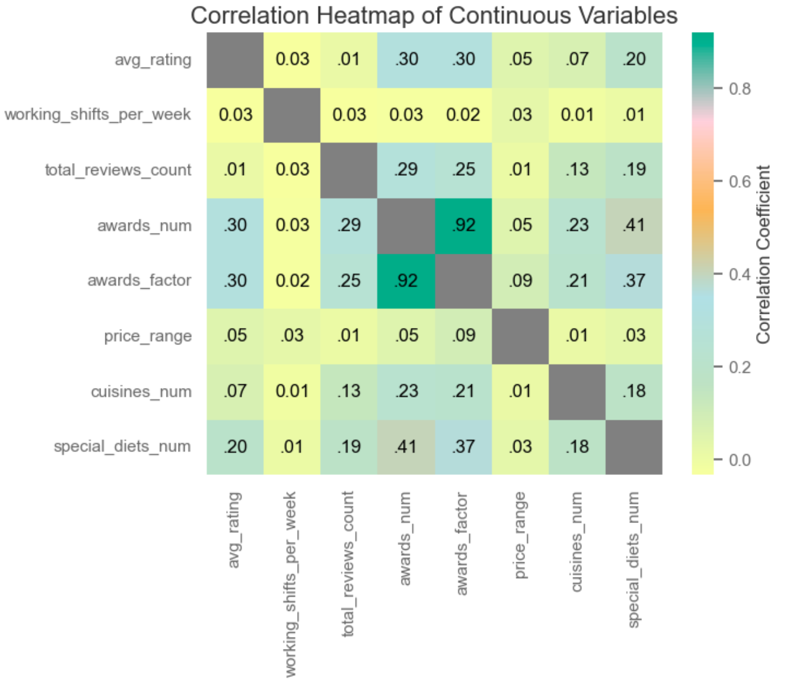
Awarded restaurants tend to gain more reviews
Awarded restaurants tend to offer more than one cuisine
Restaurants that offer special diets (e.g. vegan) gain more reviews

Slide 4
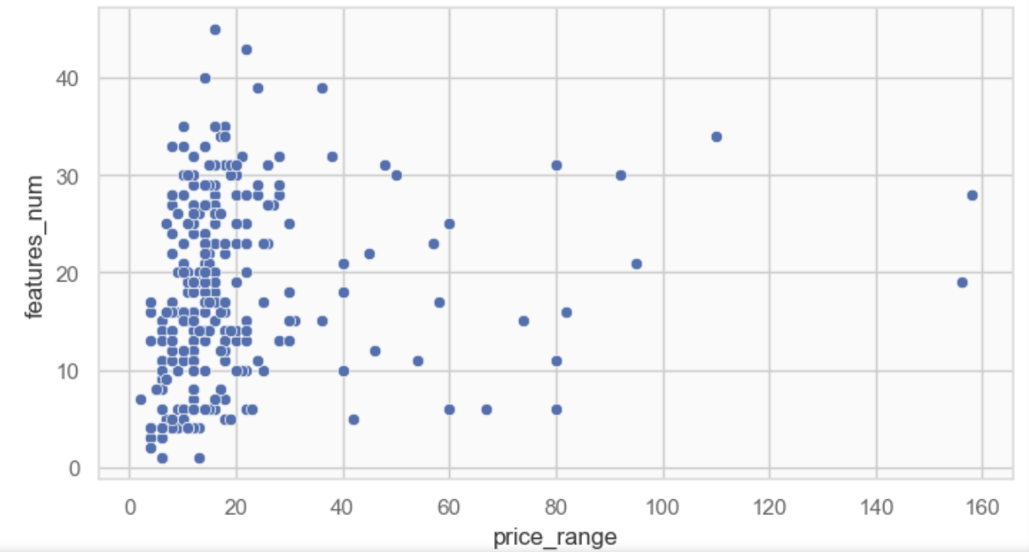
Upscale Restaurants Tend to Offer Superior Amenities
“Seating, Wheelchair Accessible, Reservations, Table Service”
price

Slide 5
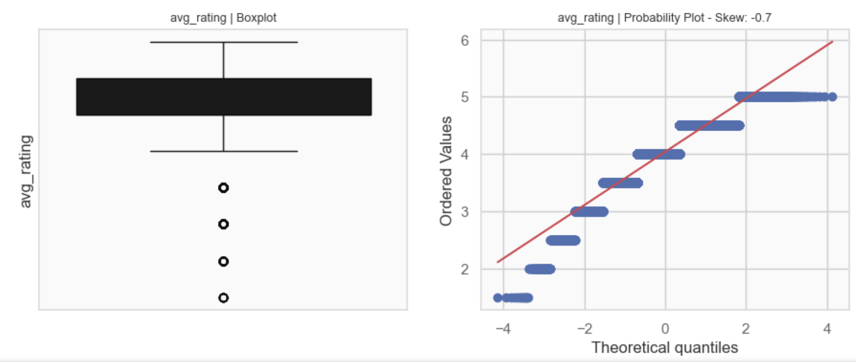
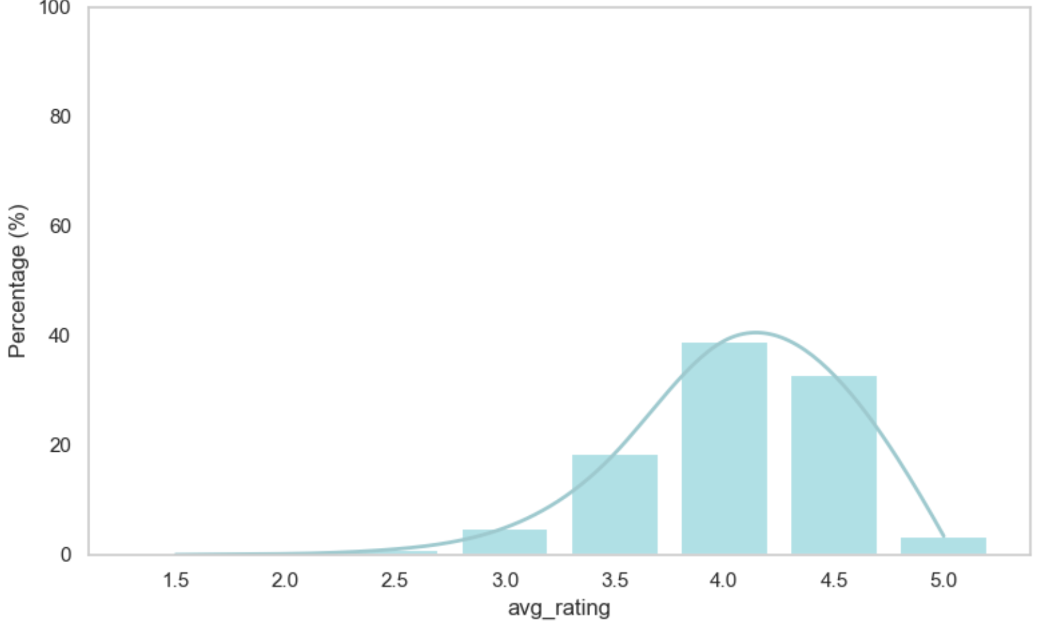

Slide 6
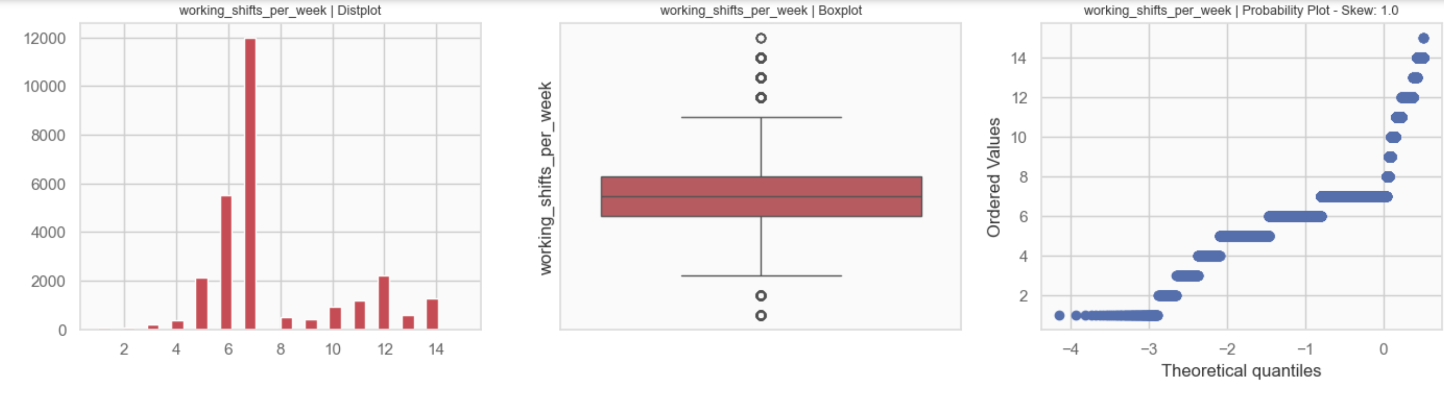
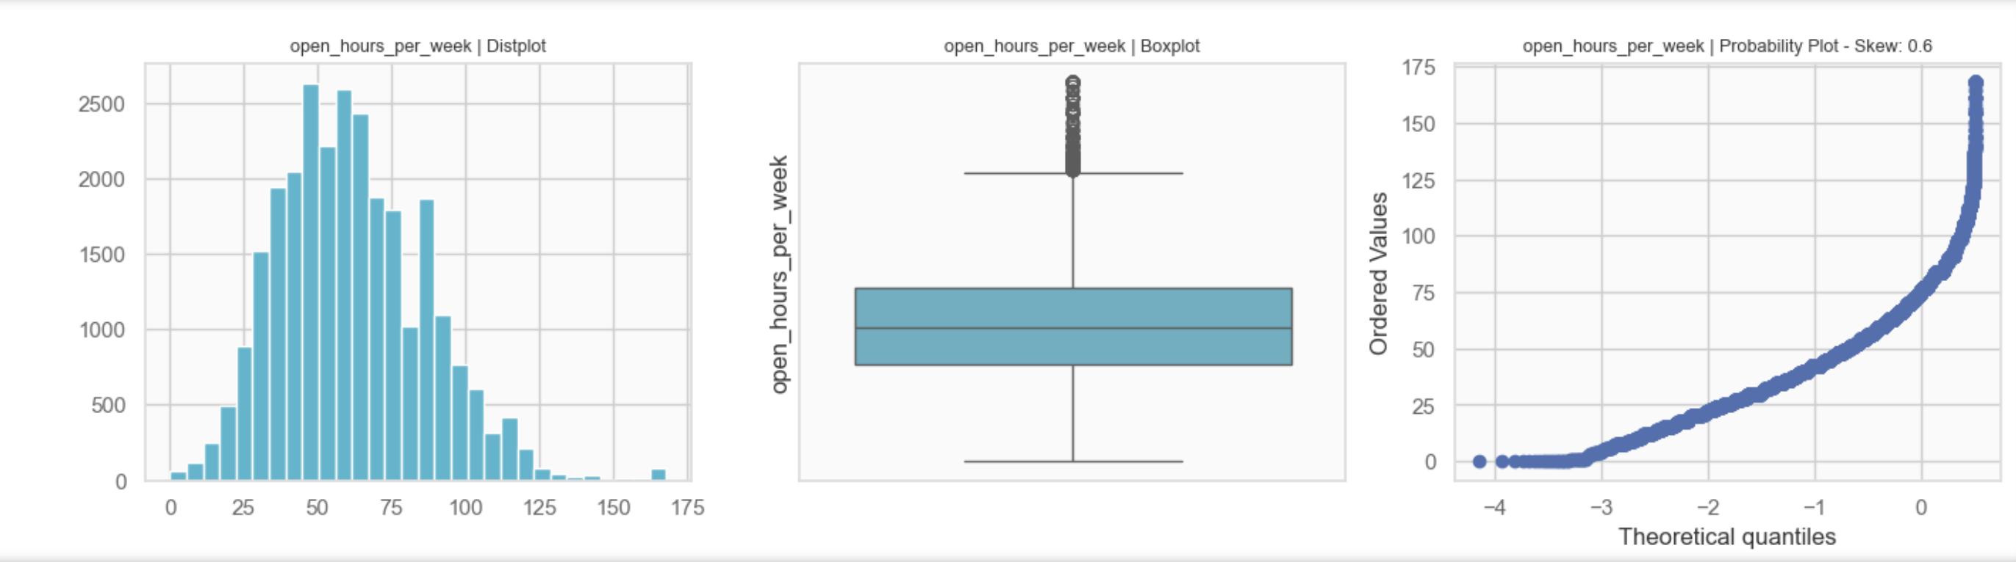

Slide 7
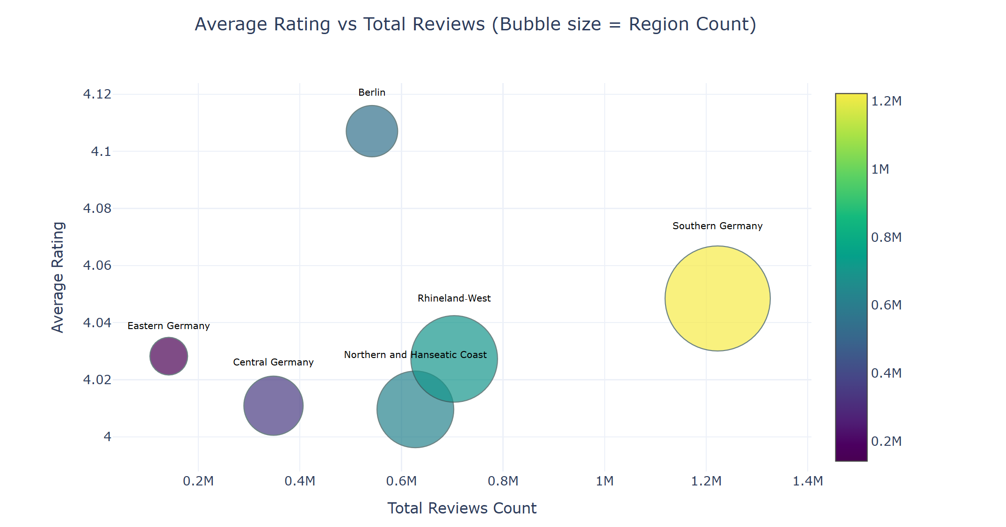

Slide 8
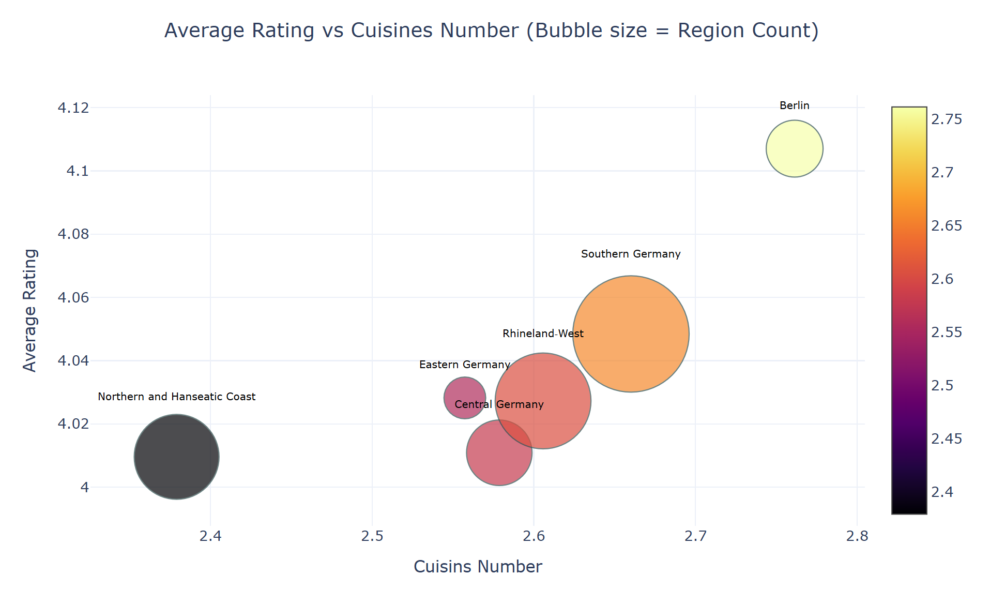

Slide 9
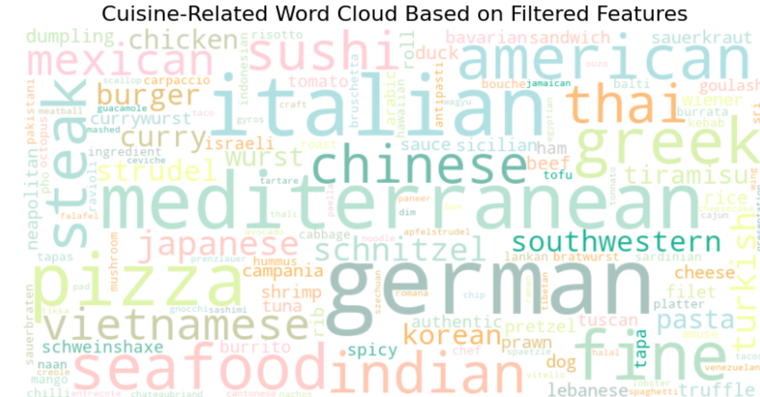

Slide 10
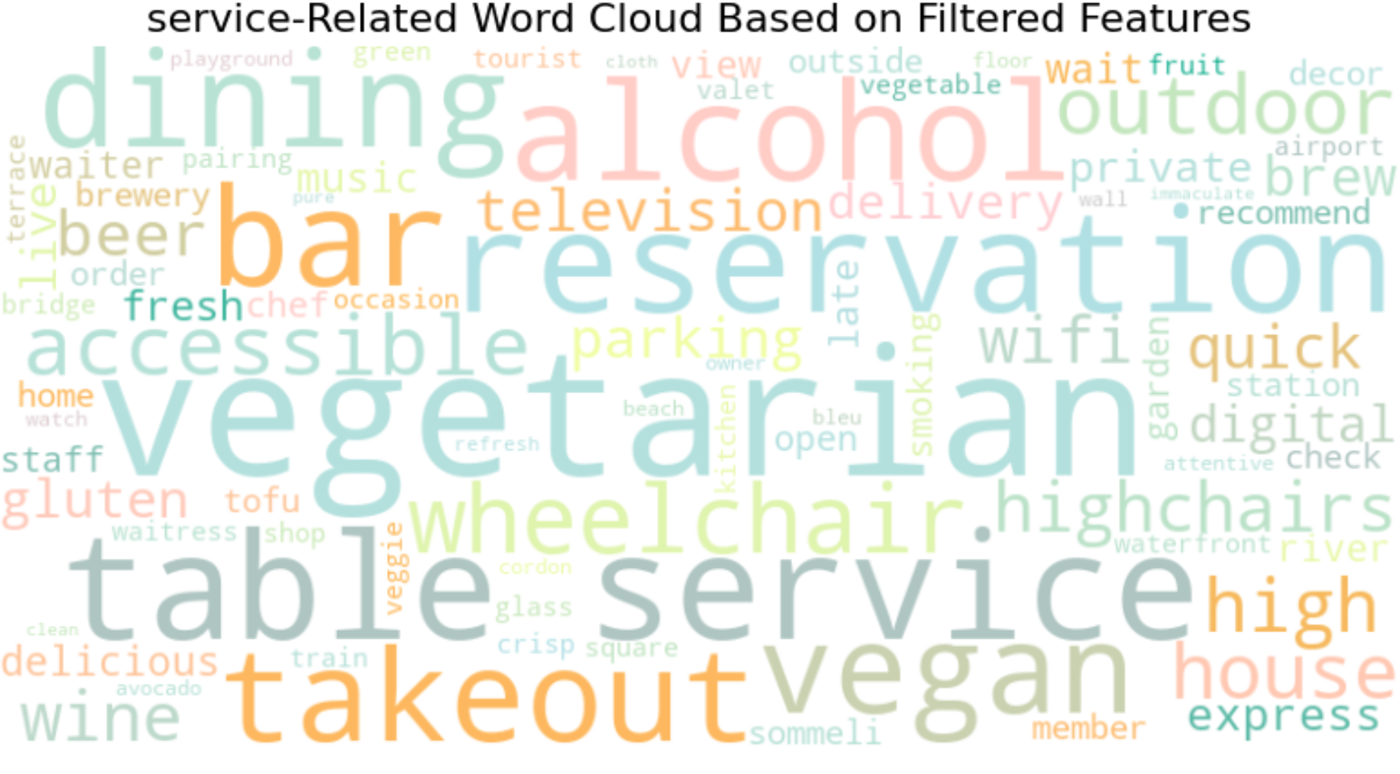

Slide 11
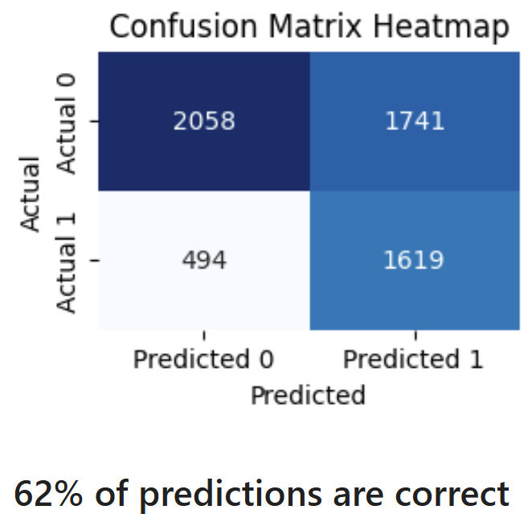

Slide 12

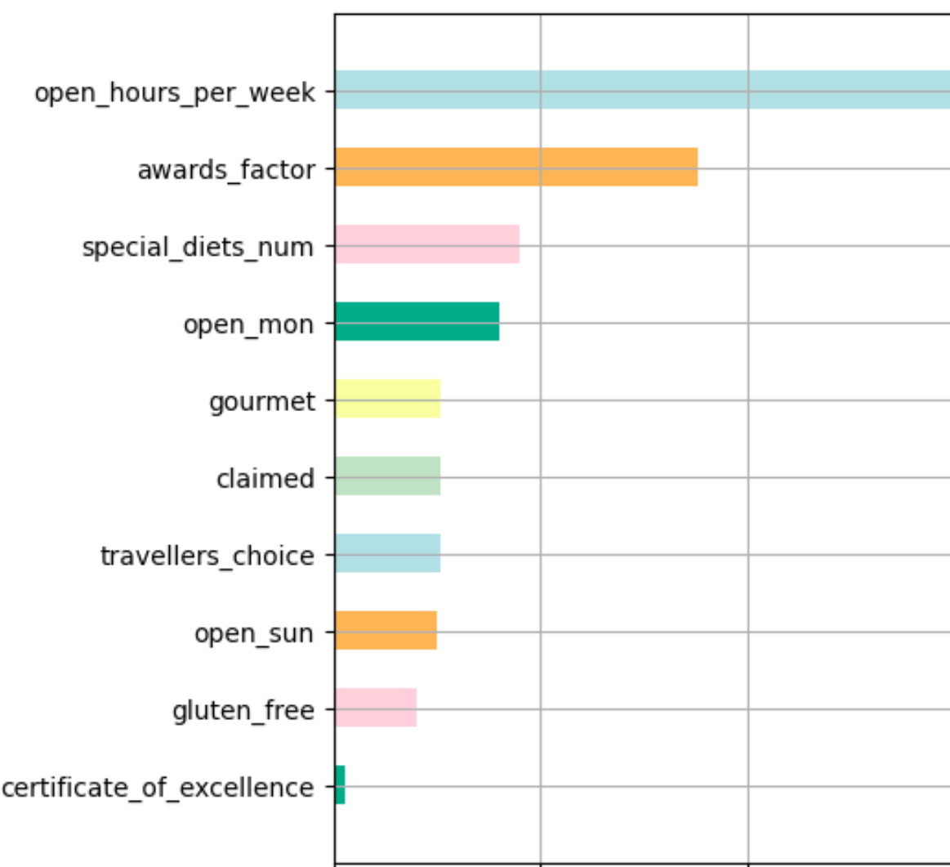
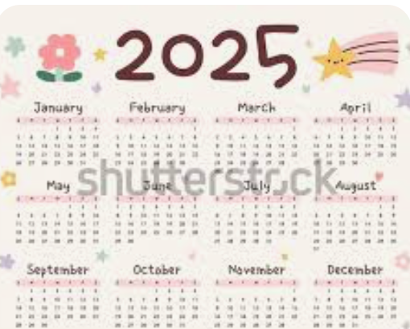

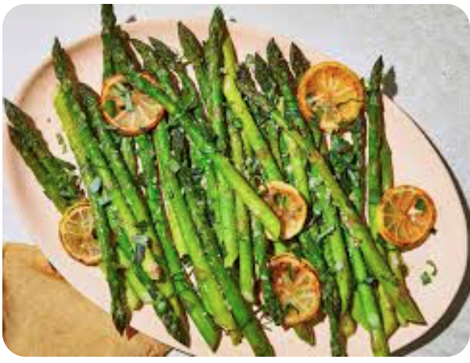


Feature Importance

